Slide 1
CDI Resolución de Ejercicios

Slide 2
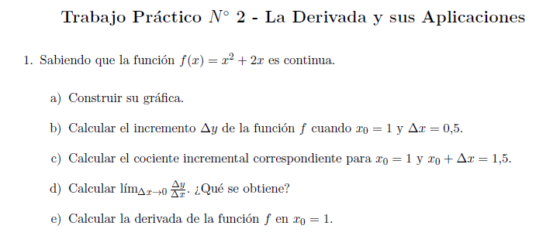

Slide 3
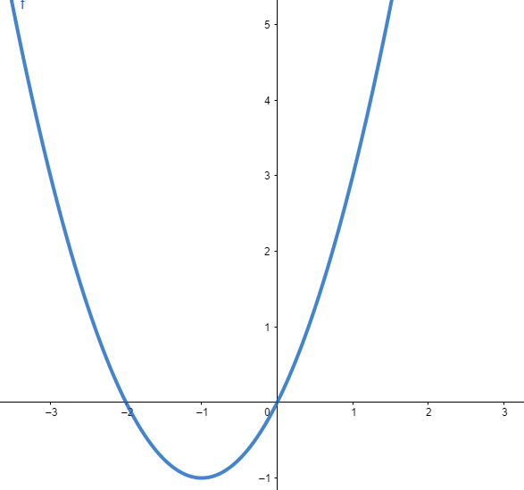









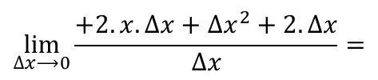






$$∆y=f\left(x_{0}+∆x\right)−f\left(x_{0}\right)=$$
$$=f\left(1+0,5\right)−f\left(1\right)=$$
$$=5,25−3=2,25$$
$$\frac{∆y}{∆x}=\frac{2,25}{0,5}=4,5$$
$$\lim_{∆x⟶0}{\frac{∆y}{∆x}=\lim_{∆x⟶0}\frac{f\left(x+∆x\right)−f\left(x\right)}{∆x}=}$$
$$\lim_{∆x⟶0}\frac{{(x+∆x)}^{2}+2.\left(x+∆x\right)−(x^{2}+2.x)}{∆x}=$$
$$=\lim_{∆x⟶0}\frac{x^{2}+2.x.∆x+{∆x}^{2}+2.x+2.∆x−x^{2}−2.x}{∆x}=$$
$$\lim_{∆x⟶0}\frac{+2.x.∆x+{∆x}^{2}+2.∆x}{∆x}=$$
$$=\lim_{∆x⟶0}\frac{2.x.∆x}{∆x}+\frac{{∆x}^{2}}{∆x}+\frac{2.∆x}{∆x}=$$
$$\lim_{∆x⟶0}2.x+∆x+2=$$
$$2.x+2$$
$$∴f^{′}(x)=2.x+2$$
$$f^{′}(1)=2.1+2=4$$

Slide 4
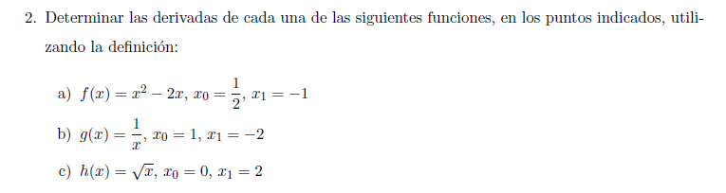

Slide 5



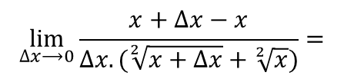




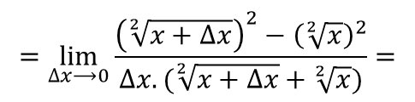
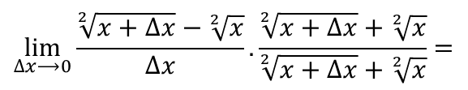
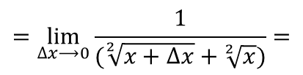



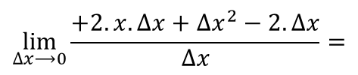
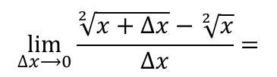

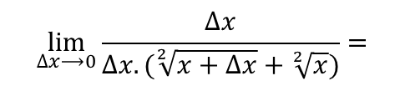




$$f^{′}(x)={\lim_{∆x⟶0}\frac{f\left(x+∆x\right)−f\left(x\right)}{∆x}=}$$
$$\lim_{∆x⟶0}\frac{{(x+∆x)}^{2}−2.\left(x+∆x\right)−(x^{2}−2.x)}{∆x}=$$
$$=\lim_{∆x⟶0}\frac{x^{2}+2.x.∆x+{∆x}^{2}−2.x−2.∆x−x^{2}+2.x}{∆x}=$$
$$\lim_{∆x⟶0}\frac{+2.x.∆x+{∆x}^{2}−2.∆x}{∆x}=$$
$$=\lim_{∆x⟶0}\frac{2.x.∆x}{∆x}+\frac{{∆x}^{2}}{∆x}−\frac{2.∆x}{∆x}=$$
$$\lim_{∆x⟶0}2.x+∆x−2=$$
$$2.x−2$$
$$∴f^{′}(x)=2.x−2$$
$$f^{′}\left(\frac{1}{2}\right)=2.\frac{1}{2}−2=−1$$
$$f^{′}\left(−1\right)=2. (−1)−2=−4$$
$${f(x)}^{′}={\lim_{∆x⟶0}\frac{f\left(x+∆x\right)−f\left(x\right)}{∆x}=}$$
$$\lim_{∆x⟶0}\frac{\sqrt[2]{x+∆x}−\sqrt[2]{x}}{∆x}=$$
$$\lim_{∆x⟶0}\frac{\sqrt[2]{x+∆x}−\sqrt[2]{x}}{∆x}.\frac{\sqrt[2]{x+∆x}+\sqrt[2]{x}}{\sqrt[2]{x+∆x}+\sqrt[2]{x}}=$$
$$=\lim_{∆x⟶0}\frac{{\left(\sqrt[2]{x+∆x}\right)}^{2}−{\left(\sqrt[2]{x}\right)}^{2}}{∆x.(\sqrt[2]{x+∆x}+\sqrt[2]{x})}=$$
$$\lim_{∆x⟶0}\frac{x+∆x−x}{∆x.(\sqrt[2]{x+∆x}+\sqrt[2]{x})}=$$
$$\lim_{∆x⟶0}\frac{∆x}{∆x.(\sqrt[2]{x+∆x}+\sqrt[2]{x})}=$$
$$=\lim_{∆x⟶0}\frac{1}{(\sqrt[2]{x+∆x}+\sqrt[2]{x})}=$$
$$\frac{1}{\sqrt[2]{x}+\sqrt[2]{x}}=\frac{1}{2.\sqrt[2]{x}}$$
$$∴f^{′}(x)=\frac{1}{2.\sqrt[2]{x}}$$
${f\left(0\right)}^{′}$No es posible. La función no es derivable en x=0
$$f^{′}(2)=\frac{1}{2.\sqrt[2]{2}}$$

Slide 6
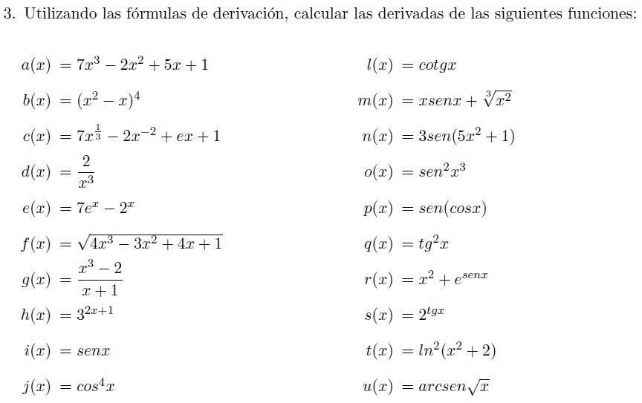

Slide 7


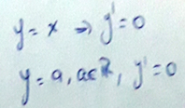

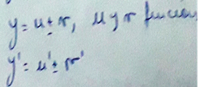

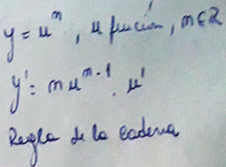






$$a^{′}\left(x\right)={21.x}^{2}−4.x+5$$
$$b^{′}\left(x\right)=4.{\left(x^{2}−x\right)}^{3}.(2.x−1)$$
d$\left(x\right)=\frac{2}{x^{3}}=2.x^{−3}$
$$d^{′}\left(x\right)=−3.2.x^{−4}=−\frac{6}{x^{4}}$$
$$e^{′}\left(x\right)=7.e^{x}−2^{x}.ln2$$
f(x), similar a la función b(x)

Slide 8

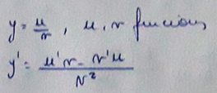











$$g^{′}\left(x\right)=\frac{3.x^{2}.\left(x+1\right)−(x^{3}−2)}{{\left(x+1\right)}^{2}}=$$
$$=\frac{3.x^{3}+3.x^{2}−x^{3}+2}{{\left(x+1\right)}^{2}}=$$
$$=\frac{2.x^{3}+3.x^{2}+2}{x^{2}+2.x+1}$$
$$h^{′}\left(x\right)=2.3^{\left(2.x+1\right)}.\ln{3}$$
$$i^{′}\left(x\right)=\cos{x}$$
$$j^{′}\left(x\right)=4.{\text{cos}}^{3}x.\left(−sen x\right)=$$
$$−4.sen x. \cos^{3}x$$

Slide 9
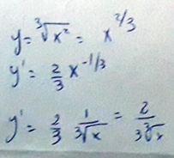






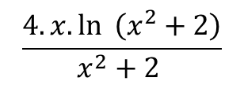





$$m^{′}\left(x\right)=sen x+x.cosx+\frac{2}{3.\sqrt[3]{x}}$$
$o^{′}\left(x\right)=2.sen x^{3}.cos{ x}^{3}.3.x^{2}$=
$$6.x^{2}.sen x^{3}.cos{ x}^{3}$$
$$p^{′}\left(x\right)=\cos\left(\cos{x}\right).(−senx)=$$
$−sen x.$ $\cos\left(\cos{x}\right)$
$$t^{′}\left(x\right)=2.\ln{ \left(x^{2}+2\right).}\frac{2.x}{x^{2}+2 }=$$
$$\frac{4.x.\ln{ \left(x^{2}+2\right)}}{x^{2}+2 }$$

